Slide 1
Exploring the Deep Work Hypothesis
Matt Anderson
Notes:
Intro – Matt Anderson – Software Eng @ AIS
Here to talk about a topic exploring recently
Deep Work by Cal Newport

Slide 2
What is Deep Work?
“Professional activities performed in a state of distraction-free concentration that push your cognitive capabilities to their limit. These efforts create new value, improve your skill, and are hard to replicate.”
Notes:
Distraction free activity
Push limits
Create new value
Improve skill

Slide 3
What is Deep Work?
“Professional activities performed in a state of distraction-free concentration that push your cognitive capabilities to their limit. These efforts create new value, improve your skill, and are hard to replicate.”
Notes:
Key: CREATING NEW VALUE

Slide 4
The Deep Work Hypothesis
“The ability to perform deep work is becoming increasingly rare at exactly the same time it is becoming increasingly valuable in our economy. As a consequence, the few who cultivate this skill, and then make it the core of their working life, will thrive.”
Notes:
Increasingly rare, yet increasingly valuable
Working deeply = thriving

Slide 5
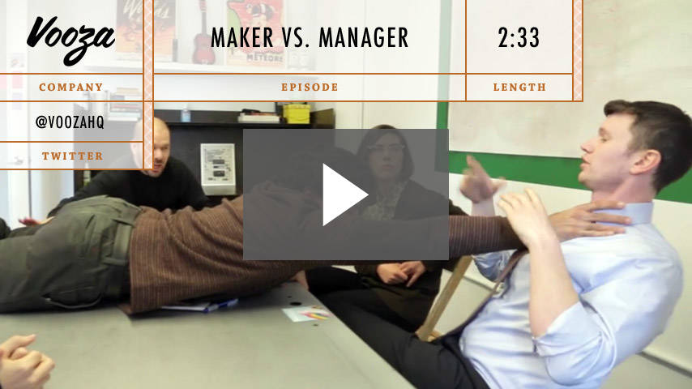
What’s the Problem?

Slide 6
What’s the Problem?
Notes:
For starters
Computers in our pockets
Constant barrage of distractions

Slide 7
What’s the Problem?
Fragmented attention
Prevents intense focus and concentration
Permanently!
Notes:
Permanently reduces our ability to work deeply in the future
If you train your brain to work a certain way, it will continue to do that in the future

Slide 8
Shallow Work
“Non-cognitively demanding, logistical-style tasks, often performed while distracted. These efforts tend to not create much new value in the world and are easy to replicate.”
Notes:
….changing economy
Silicon Valley => disruption

Slide 9
Notes:
Digital technology is transforming the economic landscape

Slide 10
A Changing Economy
Disruption!
Amazon and E-commerce
Uber and the taxis
AirBnb and the hotels
Tesla and auto industry
Self-driving cars/trucks and the logistics (trucking)
Remote work and software
Notes:
As it gets easier to hire from anywhere, competition increases
Why hire the mediocre if you can hire the elite
So how do we take advantage?

Slide 11
How to Thrive
Master hard things = (focused attention) + (feedback)
Elite production = (time spent) x (quality of focus)
Notes:
Planning is important!
Feedback: need some way to gauge improvement
Skills = brain circuits (myelination)
Attention residue and multitasking
Semi-distraction is devastating to performance
Work for extended periods with full concentration on a single task

Slide 12
Why Embrace Deep Work?
What we pay attention to matters
The “Flow” state is deeply satisfying
The Enlightenment problem
Notes:
Attention vs. circumstances
Avoid the shallow – create value
Maximize satisfaction
Flow makes us happier than just relaxing – minds enjoy challenge
Enlightenment: 18th century - reason as the primary source of authority and legitimacy
Burden of identifying meaning falls on us
Craftsmanship restores the sacred -> value process as well as outcome

Slide 13
Pragmatic Programmer on Craftsmanship
“Within the overall structure of a project there is always room for individuality and craftsmanship… One hundred years from now, our engineering may seem as archaic as the techniques used by medieval cathedral builders seem to today’s civil engineers, while our craftsmanship will still be honored.”

Slide 14
Beautiful Code
“Our programmers are our artists. They write beautiful code that millions of our travelers start to play with, to use, to help them travel better. It's a profound sense of power and satisfaction to have your work affect so many, so quickly, across the globe.”
--Dara Khosrowshahi, Expedia CEO

Slide 15
How to Work Deeply
Routines and rituals
Pick a method that fits your schedule
Bimodal
Rhythmic
Pay yourself first
Notes:
Rituals: web surfing all day then scramble to code
Use coffee to trigger it’s coding time mindset
Bimodal – one of more days of monasticism (consultant story)
Rhythmic – set aside time each day, visual reminders (X’s on calendar)
Personal finance - Schedule deep work first

Slide 16
Plan Your Ritual
Where?
How long?
How you work once you start
Support your work
Collaborate
Notes:
Where – specific location can be helpful, arrange workspace
How long – scheduling again
How work - (e.g. Internet use, metrics for success)
Support - get food, coffee, reference materials ahead of time; for me, coffee + next beverage
Collaboration – not a free pass to never interact with anyone, standups can be great for this

Slide 17
Some Hints
Set goals
Track your time
Keep a visible scorecard
Weekly review
Notes:
Set goals - what do you want to accomplish?
Track – Google docs calendar
Visible – X’s on a calendar, everyone loves streaks
Snapchat streaks 15 year old cousin
Review – are you trending in the right direction?

Slide 18
Productive Exertion
Combine exercise with problem-solving
Occupy yourself physically while focusing mentally
Expect to have to re-focus your attention often at first
Notes:
Structured thinking
Review variables => define next question => review answer => repeat
Re

Slide 19
Experiment with Intensity
Identify a high-priority task
Estimate a completion time
Attempt to complete it in significantly less time
Notes:
Teddy Roosevelt at Harvard
Do not try this too often
Helps acclimate your brain to more intense focus

Slide 20
Recharge
Stop!
Use a shutdown ritual
Let your brain rest
Notes:
End of day – don’t work after your workday ends
Not easy, sometimes necessary, don’t make it a habit
Shutdown – final email check, write down tasks or todos, review todo list, check upcoming calendar

Slide 21
Embrace Boredom
Don’t get used to distraction
Take breaks from focus, not breaks from distraction
Schedule Internet usage in advance
Notes:
Don’t get used to distraction – limits future deep work ability
Scheduled Internet
Lots of blocks OK
Respect offline blocks = IMPORTANT
Try it outside work

Slide 22
Deep Work Roadblocks
Open office layouts
Instant messaging
Cultures of connectivity
Recurring meetings
Open-ended emails
Busyness as a proxy for productivity
Shallow work is easy, deep work is hard!
Notes:
Open office: JUST DON’T
Yes, this means you Slack
Culture: set expectations, use the right medium
Make sure that meeting really matters
Emails: NO “thoughts?”
Feels good to check off lists (JIRA) or clear out inbox
Have to check myself wrt to JIRA
But are you really adding value?

Slide 23
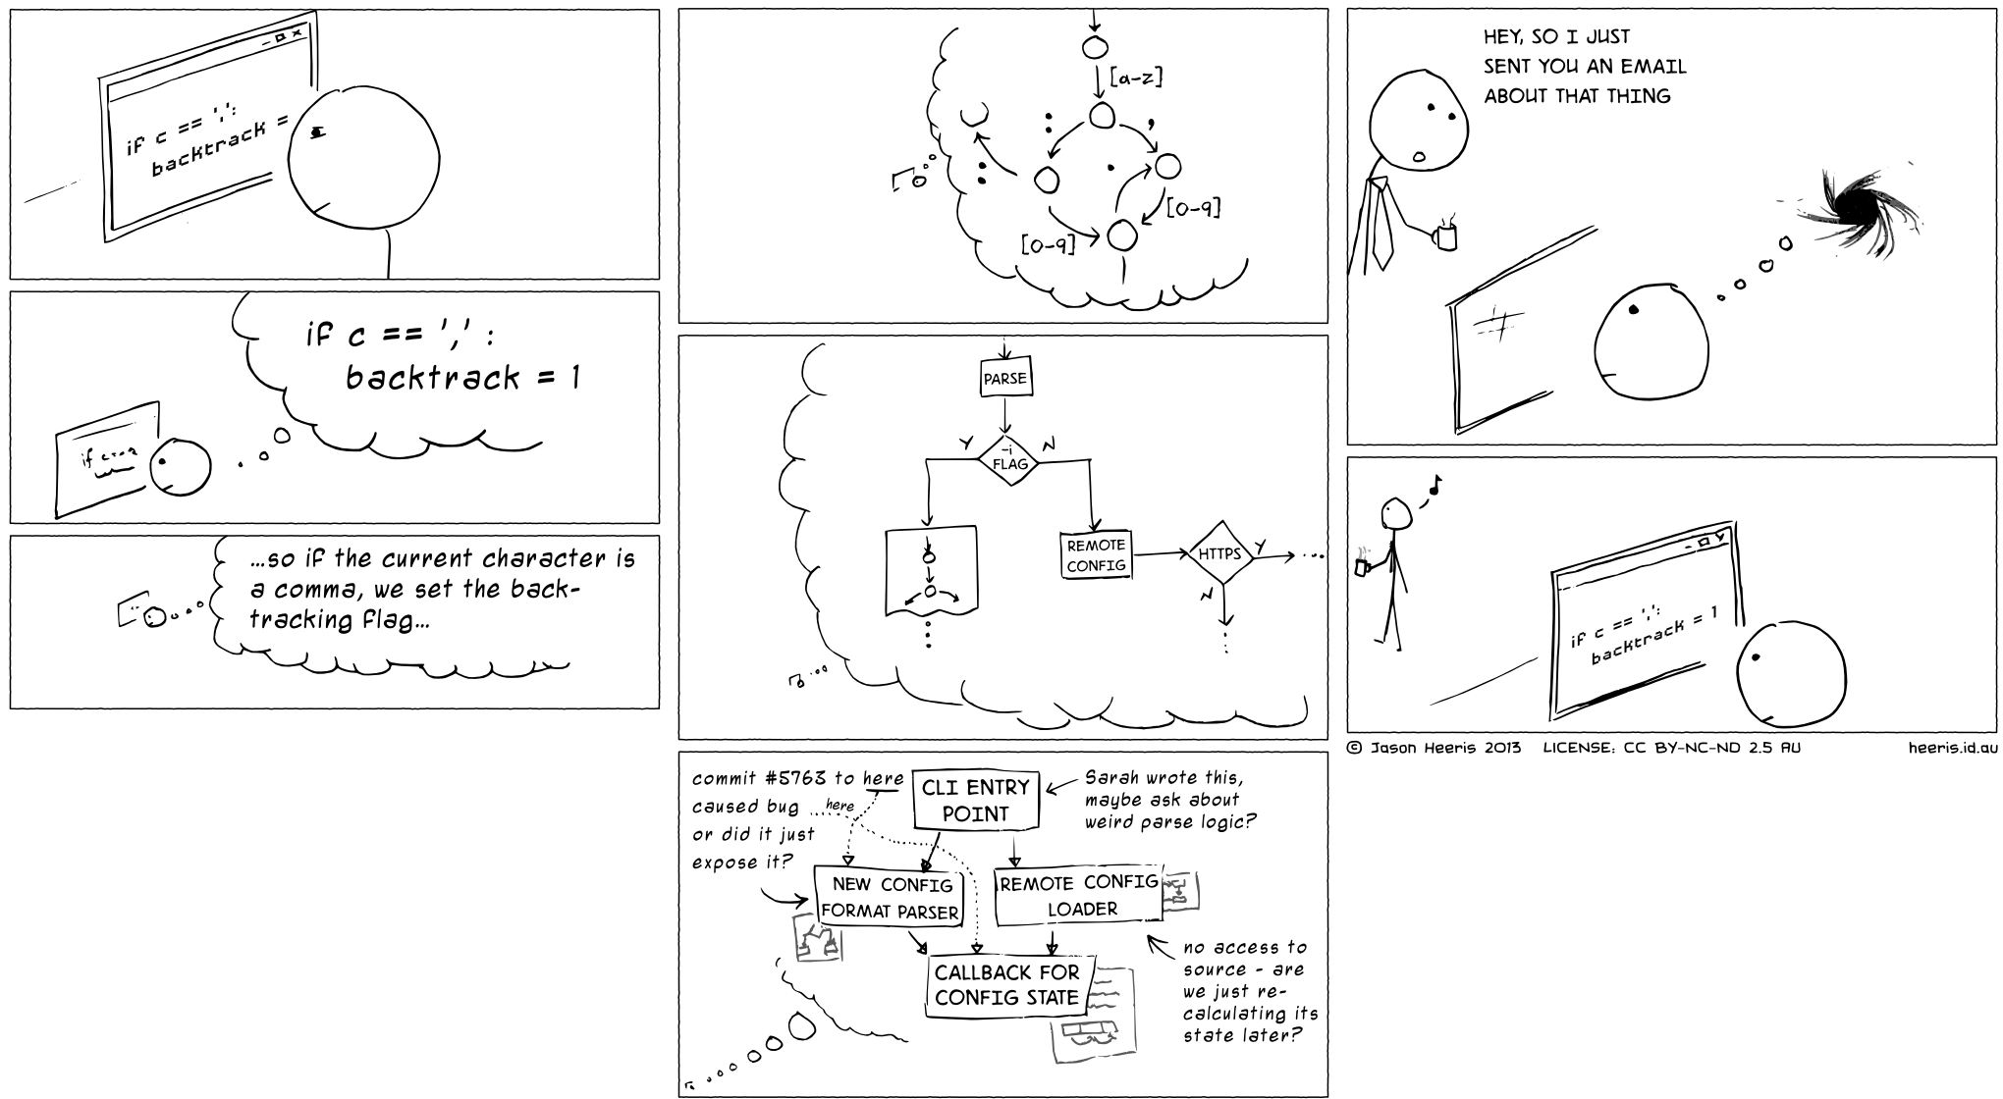
“About that Email…”
Notes:
Path of least resistance
Is it easier to just ping someone? Of course
Remember this guy?
Don’t be the one with the tie!

Slide 24
Re-evaluate Social Media
“Any-benefit” justification:
Use is justified if there is any possible benefit or anything that could be missed if not used
Social media is designed to be addicting
Notes:
This is tough, I’ve found really important things on social media
Try quitting for a month
Don’t announce: did anyone actually notice?
Would the month have been noticeably better if I hadn’t stopped using the tool?
Conquer the FOMO
ME: removed Facebook and Twitter apps, stay logged out

Slide 25
Re-evaluate Social Media
“Any-benefit” justification: use is justified if there is any possible benefit or anything that could be missed if not used

Slide 26
Be a Craftsman
Notes:
Craftsman tool selection

Slide 27
Be a Craftsman
Craftsman approach to tool selection
Identify factors for success/happiness
Adopt only if positive > negative
Notes:
Core factors for personal and professional success and happiness
Adopt a tool only if the positive impacts outweigh the negative
Identify high-level personal and profession goals
List two or three activities to help achieve each goal
Consider whether the social media you currently use has a
Substantially positive impact
Substantially negative impact
Little impact
Keep using only if the positive impacts outweigh the negative impacts

Slide 29
Example
Goal: be an effective software engineer
Activities:
Deliver quality, on-time software
Understand my customers’ needs and concerns
Stay on top of industry best practices and trends
Tool: Hacker News
Once upon a time, I subscribed to the RSS feed
Now I read the site only when I intentionally visit
In my deep work time block list
Notes:
RSS feed is a FIREHOSE
Could tell you latest JS framework

Slide 30
Put More Thought Into Leisure Time
Avoid using the Internet for entertainment
Structure your evenings and weekends
Build something! (online or physically)
Notes:
Internet as entertainment: ESPECIALLY mindless browsing
Won’t that ruin the fun of downtime?
Give your brain a quality alternative to endless infotainment
You really don’t need to read that listicle

Slide 31
Drain the S…hallows
Start your day by scheduling your day
Review and bias your time towards deep work
Ask for a shallow work budget
Be careful about saying “yes”
Notes:
Start by scheduling
Divide into blocks
Some deep work, some shallow
Revise as plans change
Guesstimation problem: overflow conditional blocks
Scraps schedule if legitimate inspiration strikes
Shallow work budget - ask your manager
Be discriminating towards new commitments

Slide 32
Disclaimer
Deep work is not for everyone
Giving your best confronts that our best is not (yet) that good
Deep work gets valuable things done
Notes:
Not for everyone: requires hard work and changes to work habits
Not always possible for managers, CEOs, people whose job is to be a decision engine
Give your best: very scary
Attempting to give your best effort forces us to confront the possibility that our best is not (yet) that good

Slide 33
My Tips + Tricks
Definitely don’t leave email open
Consider closing Slack
Pomodoro
Respect headphones
Work elsewhere
Notes:
Check Slack during breaks
Pomodoro – not perfect with emphasis on breaks but lots of tools
Sometimes just leave

Slide 34
Tools
Momentum Dashboard browser extension
SelfControl app
BeFocused app
Notes:
Momentum Dashboard – todo list, inspiring photos
SelfControl – blacklist sites
Careful, can’t turn it off!
BeFocused - Pomodoro + Todo lists

Slide 35
Resources and Recommended Reading
Deep Work by Cal Newport
Cal Newport’s blog: http://calnewport.com
Flow by Mihaly Csikszentmihalyi
Shop Class as Soulcraft by Matthew Crawford

Slide 36
A Deep Life is a Good Life
“I’ll live the focused life, because it’s the best kind there is.”
--Winifred Gallagher, Author

Slide 37
Questions?

